Slide 1
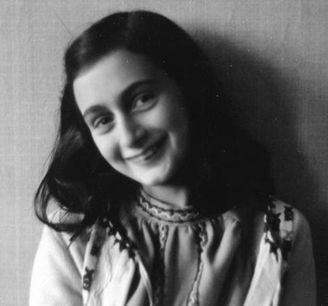
Anne Frank

Slide 2
Family Facts
Anne was born on the 12th of June 1929 in Frankfurt, Germany.
Anne is just a nickname. Her full name was Annelies Marie Frank.
Anne had a sister named Margot. She was born on the 16th of February 1926.
Margot was the more mature sister. Even though Anne was intelligent, she often got distracted by talking to her friends during school.
Anne’s parents names were Otto and Edith Frank.

Slide 3
Anne’s Diary
Anne received her diary as a gift for her 13th birthday along with some other textbooks.
Anne wrote about the war and the other family that were living with them. One of the people in the family, Peter Van Pel, was actually Anne’s boyfriend!
Anne always called her diary Kitty. Some research says that Kitty was based on a real person, one of Anne’s pre-war friends
Margot, Anne’s older sister also wrote a diary. The reason why it was never published is because it was never found.
Anne heard on the radio one day that people who are writing diaries in this troubling time must preserve them as this will be a piece of history.
Anne’s diary was published in 1947 after she sadly passed away in 1945 in a concentration camp. It was her Father’s idea to publish her diary.

Slide 4
The Frank Family go into hiding
Anne and her family went into hiding earlier than expected. Anne’s parents were planning on going into hiding on the 6th of July 1942. That was until Margot received a call-up for a German concentration camp. The Frank Family went into hiding in a secret annex behind Otto’s work place in Amsterdam. He worked for a jam company. Anne’s beloved cat, Moortje was sadly left behind. The Frank’s also shared their secret annex with another Jewish family named Van Pels and a German dentist named Fritz Pfeffer.

Slide 5
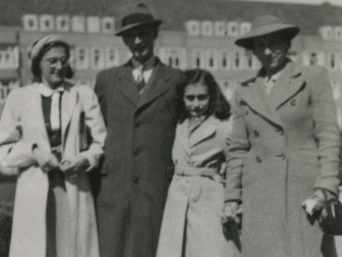
The Frank Family
Margot is on the right and Anne is on the left next to her Mother Edith and then of course Otto is in the middle of his two daughters.

